Slide 1

Analysis of Package Deliveries in Seattle
Step 1: Data Translation Challenge
Team Members: Anjali, Saad, and Tavnit

Slide 2

Introduction
Dataset
Project Workflow
Exploratory Data Analysis
Decomposition Analysis
ACF and PACF Analysis – Part 1 Original Series
ACF and PACF Analysis – Part 2 Weekly Cyclicity

Slide 3
Project Introduction
Forecast the number of daily deliveries in the Seattle Area for Company A.
Logistics: Transportation, Inventory, Order Processing Warehousing, Inventory Management
Purpose: To forecast delivery plans in order to allocate drivers, do demand planning & save money

Slide 4
Dataset
Real Data from Company A
Total Number of package deliveries in Seattle Area (Tacoma – Everett)
Frequency = Daily
January 2nd 2020 to March 31st 2023
Scale down by 10^5
(in 100 thousands)
Estimation – Prediction Sample Split 90 % - 10 %

Slide 5
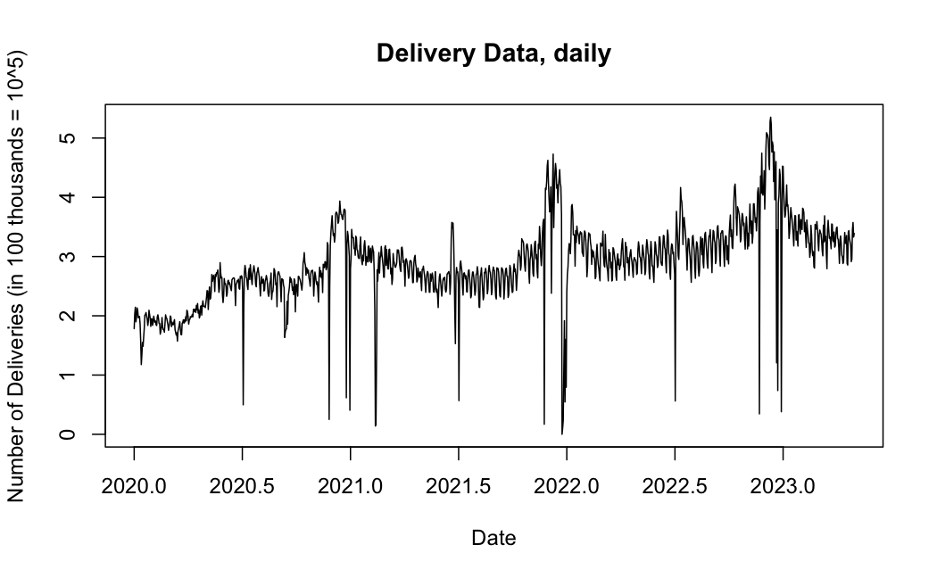
Exploratory Data Analysis
Median = 2.85, Mean = 2.88, Std = 0.679
Slight upward trend
Clear annual seasonality. Holiday shopping.
Weekly cyclical
COVID-19 buying behavior - March 2020 onwards
Dickey Fuller Test indicates Deterministic Trend. Test statistic is very low (-12.582) -> no unit root

Slide 6
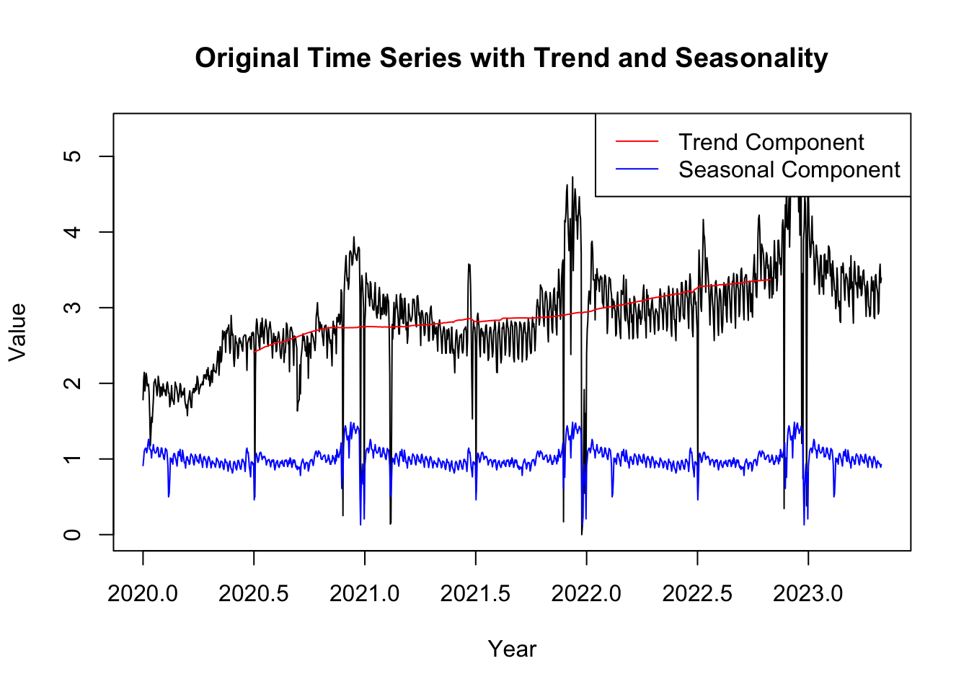
Decomposition Analysis
There is a seasonal trend.
Not enough years to predict annual seasonality
Weekly Cyclicity can be Analyzed.
Analysis with lag 7 and seasonal models with period = 7

Slide 7
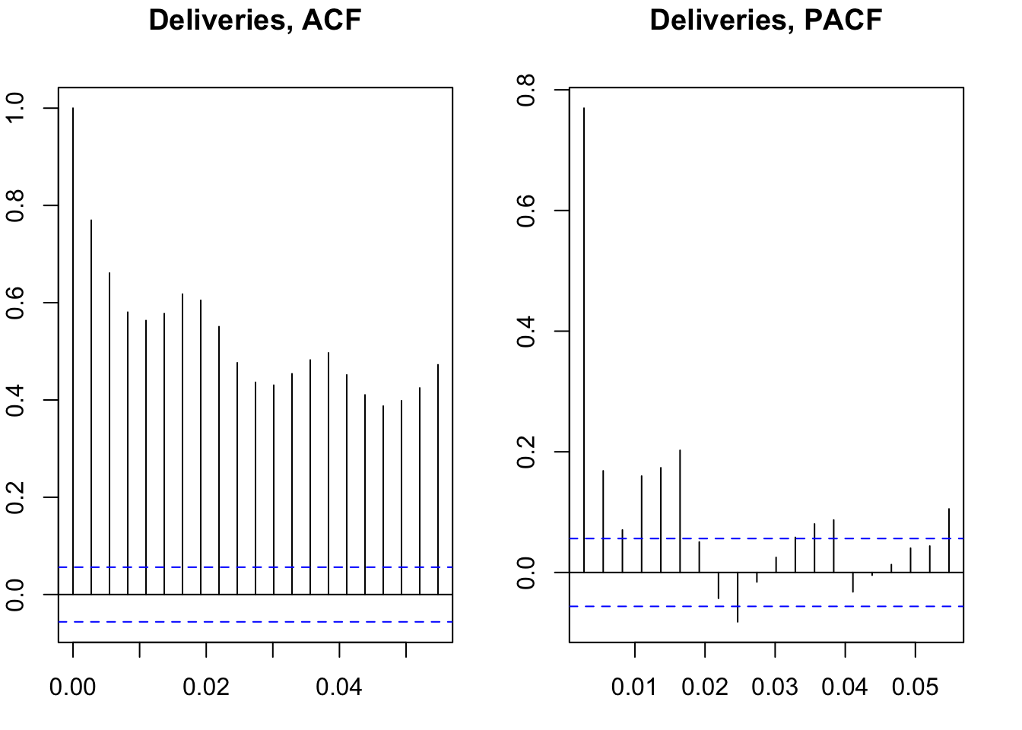
ACF & PACF PART 1 – Original Series
Features of the ACF
Gradually falling -> indicates AR models
Bumps (7 lags width) weekly cyclical pattern -> cyclical models
Features of PACF
No smooth decay towards zero – MA models not indicated.
Large Spike at lag = 1 -> AR(1)
Spikes at lag = 2,4,5,6 -> AR(2),AR(6)
There are recurring spikes -> ARMA models of ARMA(1,1), ARMA(2,2), ARMA(6,1), ARMA(6,2), ARMA(6,6)

Slide 8
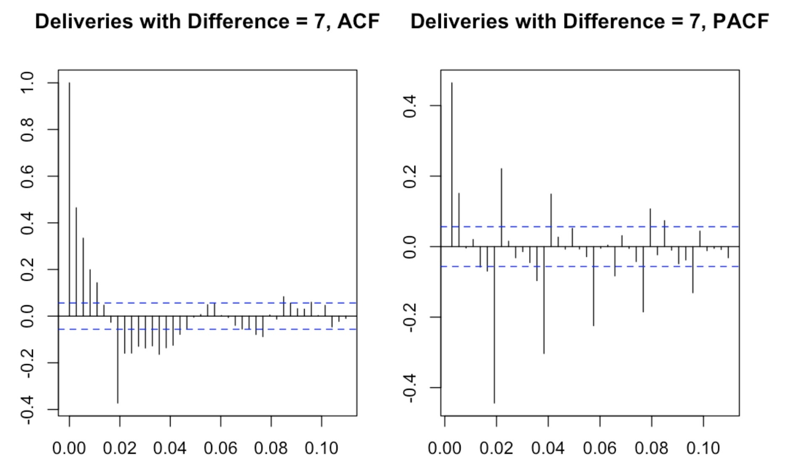
ACF & PACF Part 2 - Weekly Cycles
Features of the ACF:
Gradually falling spikes indicate AR behavior.
Spikes at lag = 1,2,3,4 and 7 -> MA 1 ... MA 4, MA7
PACF has rapidly declining autocorrelation indicates we could try MA models
Spikes at lag = 2 and 7 indicate AR(2) or AR(7).
There are recurring spikes. No need to considered the spikes after the 7th lag as these are in the cyclical pattern
Seasonal Models
Identify order using PACF, ACF of Difference = 7
Try Simpler models before complex.
Features of the PACF:
Large spike at lag = 1 indicates AR(1).
Tentative Models first tried
SARMA models with AR2 and AR7 along with MA1 and MA4.
We try the simplest form (p,0,0)(0,0,Q)[7]

Slide 9

Model Search (In-Sample Evaluations)
Tentative Models
Model Evaluation Criteria
Model Selection
Summary of Top 5 Models
Multistep Forecast

Slide 10
In-sample Evaluation
AR Models
MA models (for completeness)
AR 1
AR 2
ARMA Models
ARMA (1,1)
ARMA (1,2)
Seasonal and Auto
AR 6
AR 6, d=1
ARMA (2,2)
ARMA (2,1)
ARMA (2,2), d = 1
ARMA (2,1), d=1
ARMA (6,1), d=1
ARMA (6,2)
ARMA (6,1)
ARMA(6,6)
ARMA(6,4)
MA 1
MA 2
ARMA (6,2), d=1
ARMA(6,4), d=1
ARMA(6,6), d=1
Auto ARIMA: ARIMA(5,1,3)
SARIMA Model 3:
order =(2,0,0)
seasonal = (0,0,1)
SARIMA Model 1:
order = (2,0,0)
seasonal = (0,0,4)
order = (7,0,0)
seasonal = (0,0,1)
order = (7,0,0)
seasonal = (0,0,4)
SARIMA Model 2:
SARIMA Model 4:
Models Evaluated = 25
Check Stationarity
Check Invertibility
We consider only if both models passes upper two tests
Explanatory Power – R^Squared, AIC, BIC
Check Residuals – Plot, Box Ljung Test

Slide 11
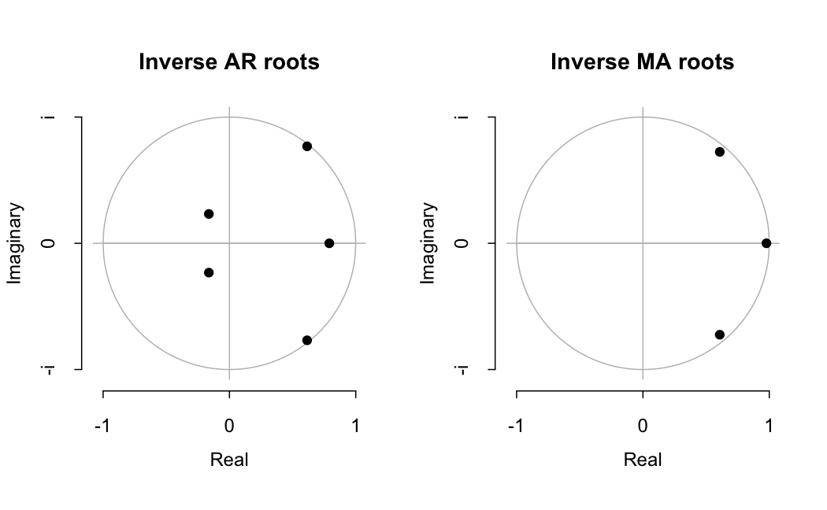
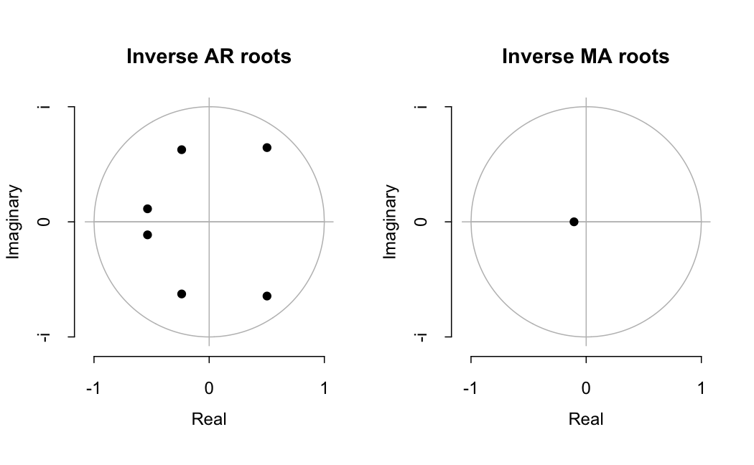
Check Stationarity and Invertibility
Auto Arima Model - ARMA (5,1,3)
ARMA (6,1,1)
Some roots are on the circle
Fail Test
No roots are on the circle
Pass Test

Slide 12

Model Selection
Model Name | AIC | BIC | R-Squared | Adjusted R-Squared | Box Ljung (p-value) | AR Roots | MA Roots
Sarima_ar7_ma4 | 1246.770 | 1313.113 | 0.6540682 | 0.6537832 | 9.532996e-01 | TRUE | TRUE
Sarima_a7_ma1 | 1267.809 | 1318.842 | 0.6461570 | 0.6458655 | 9.886236e-01 | TRUE | TRUE
ar6_d1 | 1279.758 | 1315.475 | 0.6463945 | 0.6461032 | 9.618456e-01 | TRUE | TRUE
ar6_ma1_d1 | 1281.515 | 1322.335 | 0.6465330 | 0.6462418 | 9.885346e-01 | TRUE | TRUE
ar2_ma2_d1 | 1292.706 | 1318.218 | 0.6370250 | 0.6367260 | 9.580129e-01 | TRUE | TRUE
ar1_ma1_d1 | 1295.486 | 1315.893 | 0.6355851 | 0.6352849 | 9.796896e-01 | TRUE | TRUE
Sarima_a2_ma4 | 1305.201 | 1346.028 | 0.6342961 | 0.6339949 | 6.837093e-01 | TRUE | TRUE
a1_ma2 | 1325.918 | 1351.434 | 0.6256931 | 0.6253848 | 2.819411e-01 | TRUE | TRUE
Sarima_a2_ma1 | 1356.159 | 1381.675 | 0.6162974 | 0.6159814 | 6.479105e-01 | TRUE | TRUE
ar1_ma1 | 1373.259 | 1393.672 | 0.6100961 | 0.6097750 | 8.252470e-02 | TRUE | TRUE

Slide 13
Summary of Top 5 Models
The top 5 models are selected using AIC, BIC, and Adjusted R2, which balance model fit and complexity. Lower AIC and BIC indicates superior performance.
Higher Adjusted R-Squared or R-Squared indicates better explanatory power for the model.
Ljung-Box Test assesses the independence of residuals and check if residuals are white noise.
All models demonstrate both covariance stationarity and invertibility, which are crucial for model stability and reliability.
The in-sample evaluation enables us to find models with the most optimal fit.
 | Model 1:​ | Model 2:​ | Model 3: | Model 4: | Model 5:
Name in Code | sarima_ar7_ma4​ | sarima_ar7_ma1​ | ar6_d1​ | ar6_ma1_d1 | ar2_ma2_d1
Order | SARMA (7,0,0)(0,0,4)[7] | SARMA (7,0,0)(0,0,1)[7]​ | ARMA(6,1,0) | ARMA(6,1,1)​ | ARMA(2,1,2)
Coefficients (Theta and Phi) | ar1=0.5330 ar2=0.1192 ar3=-0.0327 ar4=0.0450 ar5=0.0553 ar6=0.1641 ar7=-0.0181 sma1=0.0628 sma2=0.0605 sma3 =0.1325 sma4=0.0276 | ar1=0.5422 ar2=0.0963 ar3=-0.0394 ar4=0.0347 ar5=0.0500 ar6=0.1752 ar7=0.0485 sma1=0.0066 | ar1=-0.4408 ar2=-0.3343 ar3=-0.3636 ar4=-0.3172 ar5=-0.2566 ar6=-0.0705 | ar1=-0.5618 ar2=-0.3859 ar3=-0.4018 ar4=-0.3585 ar5=-0.2926 ar6=-0.0987 ma1=0.1214 | ar1=-0.3187 ar2=0.4709 ma1=-0.1251 ma2=-0.7833
AIC | 1246.77​ | 1267.81​ | 1279.76​ | 1281.52​ | 1292.71​
BIC / SIC | 1313.113​ | 1318.842​ | 1315.475​ | 1322.335​ | 1318.218​
R- Squared | 0.6541​ | 0.6462​ | 0.6464​ | 0.6465​ | 0.6370​
Adj R-Squared | 0.6538​ | 0.6459​ | 0.6461​ | 0.6462​ | 0.6367​
White Noise Residuals (p-value) | 0.9533​ PASS | 0.9886​ PASS | 0.9618​ PASS | 0.9885​ PASS | 0.958​ PASS
Invertibility | Yes​ | Yes​ | Yes​ | Yes​ | Yes​

Slide 14
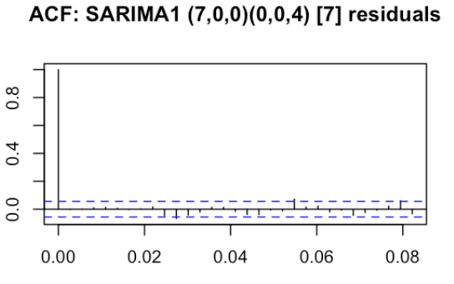
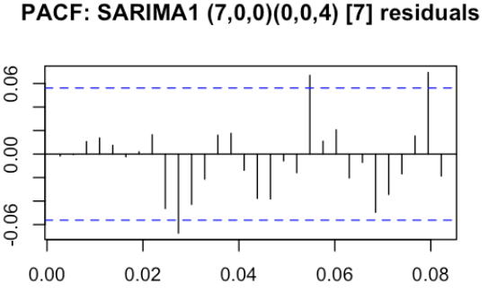
In sample evaluation Summary
Best Model: ARIMA (7,0,0) (0,0,4)₇
All the top 5 models have residuals that pass Box-Test
But the residual ACF and PACF plots show some spikes
Generate in-sample multistep forecast for 7-days
Appropriate period for usefulness
The top 5 models will be considered for out of sample evaluation.

Slide 15
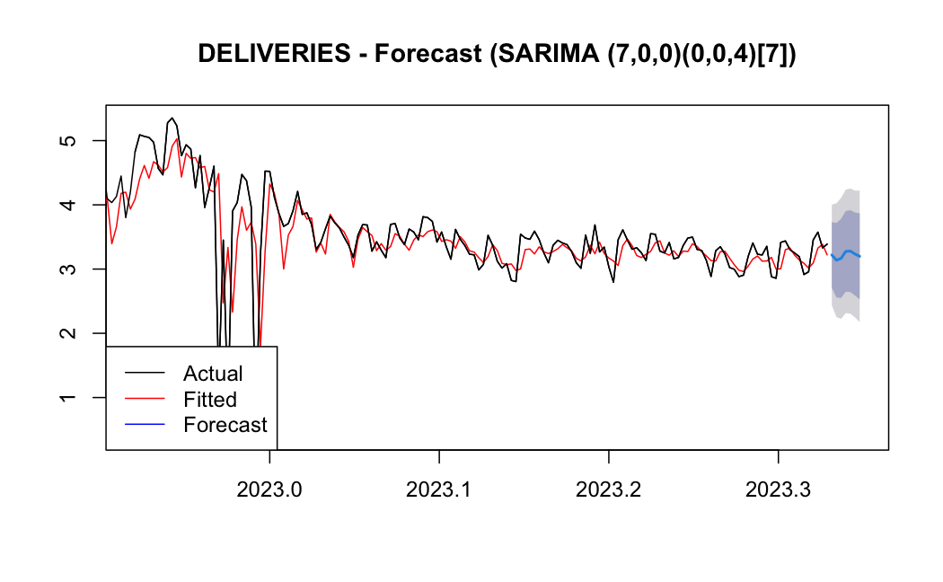
Multistep Forecast – Best Model – 7 Days Ahead
Annexure 3 has multistep forecast for the other top 5 models

Slide 16

Out of Sample Evaluations
Recursive Forecasting Environment
Forecast Optimality Tests
Assessment of Forecasts
Linear Combination models
Forecast Visualization

Slide 17
Out of Sample Evaluation
Split Data: Estimation – Prediction (90% -10%)
Forecast Recursively by updating the estimation sample
Each forecast is for 1 period (h = 1)
Check Forecast Optimality
MPE Test (Mean Prediction Error Test)
IET Test (Informational Efficiency Test)
Assess the Forecast
MSE (Mean Squared Error)
Other Metrics – RMSE, MAE, MAPE
Select the 3 best models
Construct Combination Models from 3 best models
Equal Weighted
Inverse MSE weighted
OLS Linear Combination
Visualize Forecast
Use best model and visualize the forecast for prediction sample data
Model 1
Model 2
Model 3
Model 4
Model 5
Naïve Model
Simple Average Model
Seasonal Model
SARIMA (7,0,0)(0,0,4)[7]
Seasonal Model
SARIMA (7,0,0)(0,0,1)[7]
Non-Seasonal Model
AR6 = ARMA(6,1,0)
Non-Seasonal Model
ARMA(6,1,1)
Non-Seasonal Model
ARMA(2,1,2)
last period value
Average of last 4 periods

Slide 18
Predictive Ability Assessment Outputs
Model | MSE | ME | RMSE | MAE | MPE | MAPE
Model 1 SARMA (7,0,0)(0,0,4)[7] | 0.02670103 | 0.05941091 | 0.1634045 | 0.1264254 | 1.499267 | 3.675692
Model 2 SARMA (7,0,0)(0,0,1)[7] | 0.01878746 | 0.04820287 | 0.1370673 | 0.1071776 | 1.19126 | 3.120265
Model 3 = ARMA (6,1,0) | 0.01605916 | 0.001266935 | 0.1267247 | 0.09687102 | -0.1688755 | 2.883118
Model 4 = ARMA(6,1,1) | 0.01643544 | 0.001367634 | 0.1282008 | 0.09796088 | -0.1673004 | 2.914466
Model 5 = ARMA(2,1,2) | 0.013016 | -0.03837299 | 0.1140877 | 0.08870377 | -1.336391 | 2.6858
Naïve Model | 0.06972841 | 0.001369918 | 0.2640614 | 0.1928634 | -0.2490005 | 5.621549
Simple Average Model | 0.1097014 | 0.01598162 | 0.331212 | 0.2437092 | -0.1190842 | 7.071301
Annexure 2a has details on all the metrics presented here

Slide 19
Out of Sample Evaluation Results
Model Name | MPE Test | Mpe Test | IET Test | IET Test | MSE
 | P-value | Result | P-value | Result
Model 1 SARMA (7,0,0)(0,0,4)[7] | 3.57e-05 | FAIL | 0.0287 | FAIL | 0.02670103
Model 2 SARMA (7,0,0)(0,0,1)[7] | 3.57e-05 | FAIL | 3.532e-05 | FAIL | 0.01878746
Model 3 = ARMA (6,1,0) | 0.913 | PASS | 0.011 | FAIL | 0.01605916
Model 4 = ARMA(6,1,1) | 0.907 | PASS | 0.01489 | FAIL | 0.01643544
Model 5 = ARMA(2,1,2) | 0.000143 | FAIL | 7.34e-07 | FAIL | 0.013016
Naïve Model | 0.955 | PASS | 9.021e-07 | FAIL | 0.06972841
Simple Average Model | 0.596 | PASS | 1.871e-07 | FAIL | 0.1097014
All individual models fail at least 1 test.
The 5 models significantly better (much lower) MSE that the Naïve Model and Simple Average Model indicating they have better explanatory power

Slide 20
Combination Models
Combination Model 1:
Equally Weighted
1/3*Model 3 + 1/3*Model 4 + 1/3*Model 5
Combination Model 2:
Inverse of MSE
1/MSE3*Model 3 + 1/MSE4 *Model4 + 1/MSE5*Model 5
Combination Model 3:
OLS Weighted
Based on MSE we consider the top 3 models
Model 3 = ARMA (6,1,0)
Model 4 = ARMA(6,1,1)
Model 5 = ARMA (2,1,2)
Seasonal Models perform better in sample as compared to out of sample.
3 combination models

Slide 21
Combination of Forecast
​ | Combination Model 1​ Equal Weighted​ | Combination Model 2​ Inverse MSE Weighted​ | Combination Model 3​ OLS weighted​
Model 3 = ARMA (6,1,0)​ MSE = 0.01605916​ | 1/3​ | 0.3114385 ​ ​ | 3.8382​
Model 4 = ARMA (6,1,1)​ MSE = 0.01643544​ | 1/3​ | 0.3043083​ ​ | -3.5130​
Model 5 = ARMA (2,1,2)​ MSE = 0.013016​ | 1/3​ | 0.3842533​ | 0.8644​
MSE of combined forecast​ | 0.01310528​ | 0.01280656​ | 0.008805348​
MPE Test​ | P-value = 0.252, PASS​ | P-value = 0.175, PASS​ | P-value = 1, PASS​
IET Test​ | P-value = 3.243e-05, FAIL​ | P-value = 1.239e-05, FAIL​ | P-value = 1, PASS​
Combination Model 3 passes all tests and has significant improvement in MSE.
The OLS weighted forecast optimal forecast is the best forecast
Visualize the forecast

Slide 22
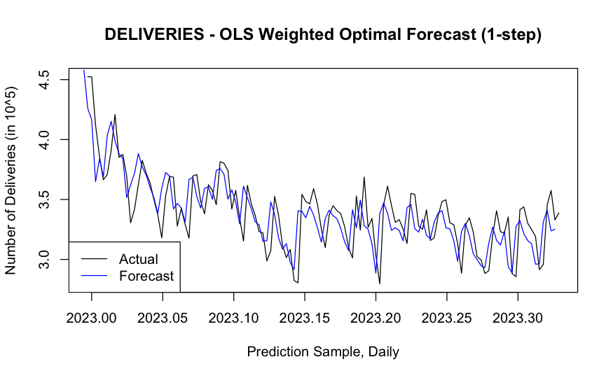
OLS Weighted Combination Model
Forecast Equation = -0.6762
+ 3.8382*(forecast from ARMA(6,1,0) )
+ (-3.5130)*(forecast from ARMA(6,1,1))
+ 0.8644*(forecast from ARMA (2,1,2))

Slide 23

Conclusion & Future Work
Analyzed a real time series data and generated forecast that Company A can use to predict delivery volumes.
Enable optimally allocate resources to ensure correct delivery planning
Multivariate analysis
personal income /consumption data
interest rate data
other company specific data (discounts, deals)
Analyze deeper why many of our models failed the forecast optimality test.

Slide 24
Thank you!

Slide 25
Annexure 1: References
https://stats.stackexchange.com/questions/194453/interpreting-accuracy-results-for-an-arima-model-fit
https://online.stat.psu.edu/stat510/lesson/4/4.2
https://otexts.com/fpp2/seasonal-arima.html
https://otexts.com/fpp2/arima-r.html
https://otexts.com/fpp2/non-seasonal-arima.html
https://online.stat.psu.edu/stat510/lesson/4/4.1
https://timeseriesreasoning.com/contents/regression-with-arima-errors-model/
https://stackoverflow.com/questions/59918142/creating-arima-model-with-a-minimum-value-of-forecast-error-in-r
https://stackoverflow.com/questions/54232180/appending-time-series

Slide 26
Annexure 2a – Glossary of Metrics
R-Squared: Proportion of the sample variation of the dependent variable in a regression model explained by the model's regressors. Adjusted R-square penalizes additional irrelevant regressors. Higher value is better.
AIC (Akaike Information Criterion): Measures to select the best time series models by minimizing the residual variances. Penalizes additional irrelevant regressors. Lower value is better.
MSE (Mean Squared Error): The sum of squared difference between the values that are fitted by the model, and observed values that are divided by the number of historical points, minus the number of parameters in the model. The number of parameters in the model is subtracted from the number of historical points to be consistent with an unbiased model variance estimate.
RMSE (Root Mean Squared Error): The square root of the MSE.
MAE (Mean Absolute Error):Computed as the average absolute difference between the values fitted by the model (one-step ahead in-sample forecast), and the observed historical data.
MPE (Mean Percentage Error): showing the average percentage difference between the predicted and actual values.
MAPE (Mean Absolute Percentage Error): The average absolute percent difference between the values that are fitted by the model and the observed data values.

Slide 27
Annexure 2b – Glossary of Tests
DF Test / Dickey Fuller Test: Statistic to assess the presence of unit root. If the null hypothesis can be rejected there is no unit root.
Box LJung Test for White Noise: Test used to check if the residuals are white noise i.e. lack of autocorrelation. Rejecting the null hypothesis indicates that the residual is not white noise.
MPE Test (mean prediction error test): Statistical assessment of whether the expected value of the forecast is zero in the case of symmetric loss function. Rejecting the null hypothesis indicates that the expected value of the forecast is not zero for symmetric loss function.
IET (information efficiency test): Statistical assessment of whether the optimal forecast error in uncorrelated with any variables(s) in the information set. Rejecting the null hypothesis indicates that the optimal forecast is not completely uncorrelated with any variables in the information set.

Slide 28
Annexure 2c – Glossary of Terms
ACF (Auto-correlation Function): Collection of correlation coefficients between any two random variables in the stochastic process that are k periods apart for k = 1,2,3 ...
PACF (Partial Auto-correlation Function): Controls for the information that runs in between the periods
ARMA (auto regressive moving average model): Equation = (p, d, q) where p = order AR process, d = order of the difference, q = order of the MA process.
SARMA (Seasonal auto regressive model) : Equation = (p, d, q)(P, D, Q)[period] where (p, d, q) is same as ARMA model. (P, D, Q) represent the order of the seasonal term and period denotes the frequency.
OLS (ordinary least squares ): Estimation technique to obtain the regression of coefficients that consists of minimizing the sum of squared residuals of the model.

Slide 29

Annexure 3a: Multistep Forecast Model 2 – 7 Days Ahead

Slide 30
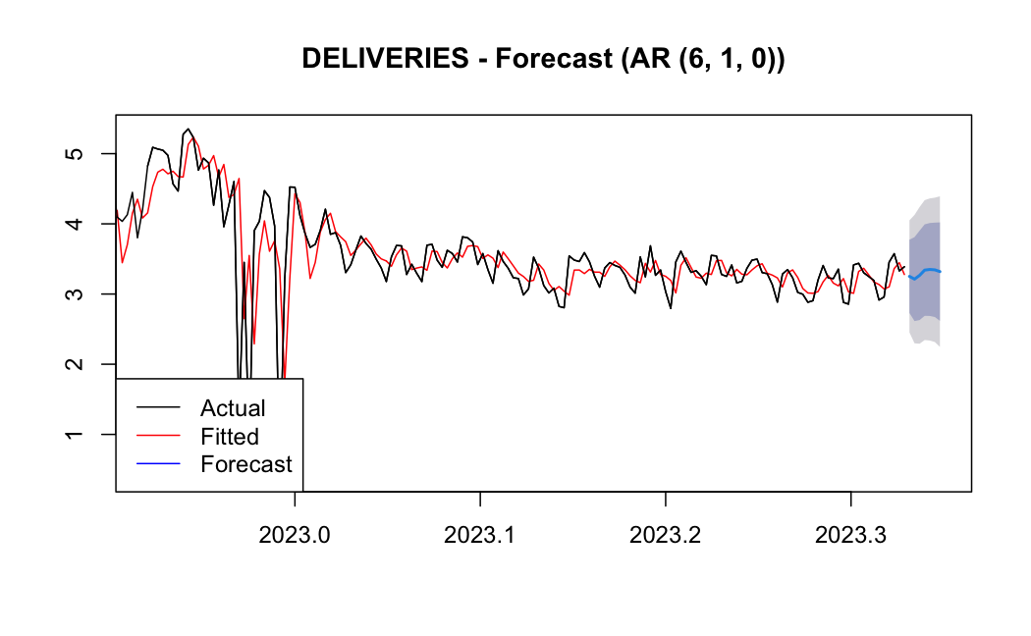
Annexure 3b: Multistep Forecast Model 3 – 7 Days Ahead

Slide 31
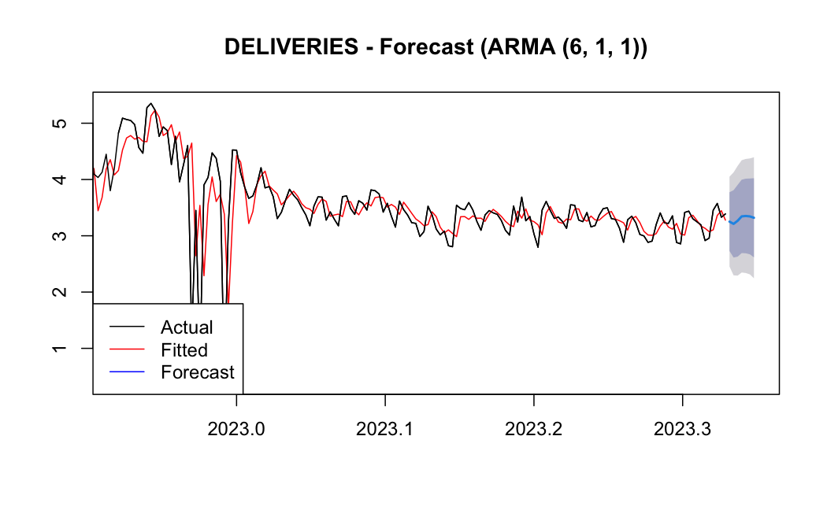
Annexure 3c: Multistep Forecast Model 4 – 7 Days Ahead

Slide 32
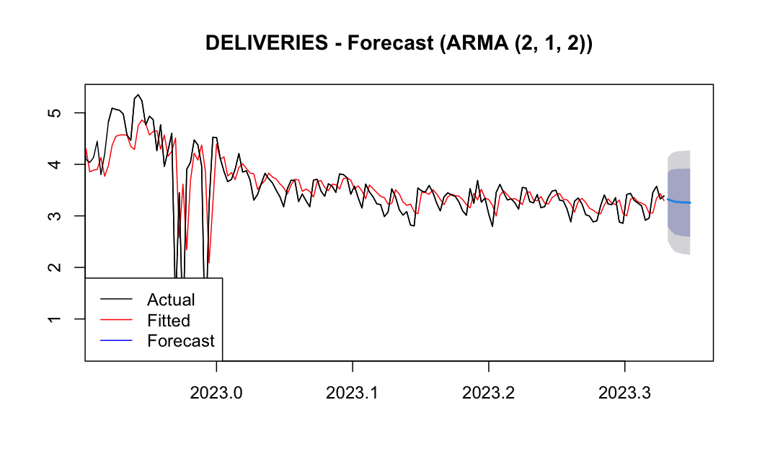
Annexure 3d: Multistep Forecast Model 5 – 7 Days Ahead

Slide 33
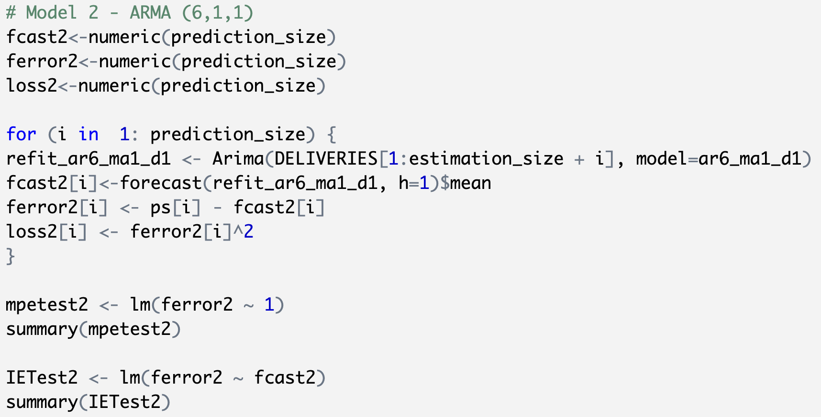
Annexure 4: Forecast Optimality Test Code

